Slide 1
Major Scale Theory
LEARNING TARGETS:
I can analyze the major scale formula using intervals
I can identify and perform a major scale using scale degree numbers
I can identify and perform a major scale using solfege syllables

Slide 2
Major Scale Formula:

Slide 3
Scale Degree Numbers:
Solfege:
1
2
3
4
5
6
7
8
Do
Re
Mi
Fa
Sol
La
Ti
Do

Slide 4
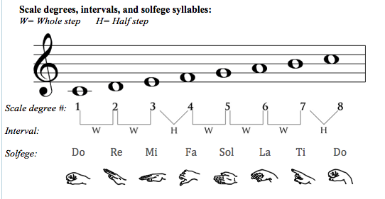

Slide 5
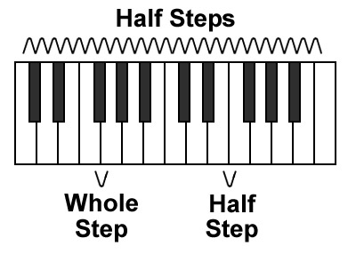
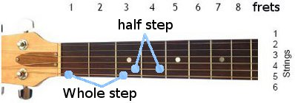

Slide 6
Concert Pitch Transpositions
LEARNING TARGETS:
I can explain the difference between concert pitch and written pitch
I can transpose a concert key pitch for Bb, F, and Eb instruments by analyzing the transposition formulas

Slide 7
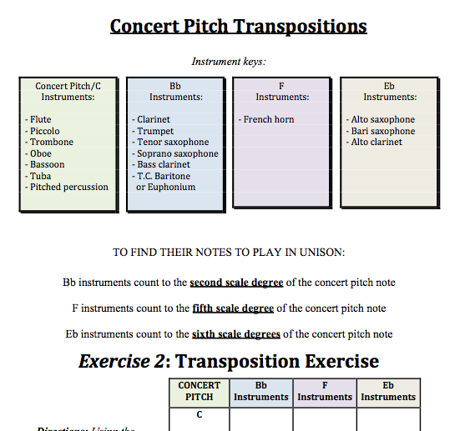

Slide 8
Major Scale Tonality
in Music
LEARNING TARGETS:
I can use one major scale element (ex: solfege) to figure out another major scale element (ex: concert pitch transposition)
I can analyze scale degree elements (ex: solfege, scale degree numbers, etc.) within the context of real music
I can perform my E major and Ab major scales without reading musical notation.

